Slide 1


Practical Advice for a Successful Career in Technology
Joe Wroblewski
CIO/CTO
Abacus Health Solutions
Stonehill College BS in CS ‘97
Bryant University MBA ‘07

Slide 2

Agenda
About Me
Stonehill Education Foundation
Practical Advice for Technologists
Resume Success (i.e., How to get hired fast)
Internships
Enterprise Technology Stack at Abacus
Machine Learning/AI in practice
Questions

Slide 3
Stonehill Computer Science Degree
Bryant University – MBA
Internships
First Job: Defense Contractor
Second Job: Marketing Services Firm
Third Job: Abacus Health Solutions
  Technical Team Leader
  IT Director
  IT/Operations Director
  CTO/CIO
About Me
2022 Copyright Abacus Health Solutions, LLC

Slide 4

Stonehill Advantages
Small Classes / Accessible Professors
Solid Education
These are the building blocks for your career
Team Effort and Group Work
Relationships & Alumni Network

Slide 5
Practical Advice
Do these now and all through your career. This list is not exhaustive but is based on my experience and what I’ve seen from others.
ACTIONS
  Deep Dive: Become an expert in something
  But also be well-rounded
  Take on a passion project
  Lean-in on projects
  Find Mentor(s)
  Internship(s)
Tools & Approach
Design Patterns
Write Clean Code
Software Testing
Be Open and Flexible to Continue Learning
Be Lucky
2022 Copyright Abacus Health Solutions, LLC

Slide 6


Key Technology Topics
Technology Mastery
Tools & Languages
    Use these to build your solutions to address real problems:
  Machine Learning/AI (Python)
  API creation and consumption
  Containers (Kubernetes/Docker)
  Databases (Relational or NoSQL)
    JSON
    SQL
  Keep Learning New Language Syntax
2021 Copyright Abacus Health Solutions, LLC
2020 Copyright Abacus Health Solutions, LLC
2022 Copyright Abacus Health Solutions, LLC

Slide 7

Key Technology Topics
Technology Mastery
  Platforms & Approaches
    Ensure your solutions leverage these to address real problems:
  Cloud Computing
    PaaS, SaaS, IaaS
    Serverless
    Scalability
  Networking Considerations
  Security
  Design Patterns/Reusability
2020 Copyright Abacus Health Solutions, LLC
2022 Copyright Abacus Health Solutions, LLC

Slide 8

What I look for when reviewing Technology Resumes
Getting hired is easy if you show:
Subject Mastery
      Demonstrate Knowledge
      Relevant Projects & Accomplishments
      Show you can adapt and learn
      Relevant Experience
Communication Skills
      Write clearly
      Basic formatting
Resume Success
2022 Copyright Abacus Health Solutions, LLC

Slide 9
Internships are a win-win!
Sample projects Interns have worked on:
API Development and Unit Testing
Automated Testing Frameworks
Real-time text parser
Phone System Data Collector
Machine Learning/AI Pipeline development
Mobile Application Prototype Development
Excel Automation and Data Extraction
Quality Control Testing
Data Collection Webdriver
File Transfer automation
AI-based document scanning
Resume Success
Internship Projects at Abacus
2022 Copyright Abacus Health Solutions, LLC

Slide 10

Mission
Leverage Behavioral Science, Technology and Informatics to improve the management of Chronic Health Conditions
2022 Copyright Abacus Health Solutions, LLC

Slide 11
Abacus Platform Technical Overview
Platform Services
  Cloud-based participant-facing interface with Data Synchronization to enable On-Prem Analytics and Operations
  Platform Operational Components:
  Data Warehouse
    Eligibility, Claims, Program Status, Communications
    Analytics Data Models
    Algorithms for risk-identification
  Tailored Messaging and Outreach Enablement: SMS, email, inbox, mailings, phone (inbound/outbound)
  Administrative and Clinical Support Tools enhance service delivery
  Multiple external data integrations
  Technology Implementation
  Participant Portal and full-featured API: Cloud-based auto-scaling and geo-redundancy
  Industry-Standard IT/Dev Tools and Processes
  Platform and Business Environment Protected by suite of Security Tools, Policies, and Procedures

Slide 12
Good Health Gateway Platform
Data
Warehouse
Multi-channel Communications Hub
Behavior Monitoring + Feedback
Clinical Support + Education Hub
Incentive Administration
Machine Learning/AI

Slide 13
Relevant Enterprise Technology
REST APIs
Databases and Data Warehouse
Web & Mobile Development
Desktop & Automation Development
Machine Learning & AI
2022 Copyright Abacus Health Solutions, LLC

Slide 14
Technology and Informatics Roadmap

Slide 15

Abacus Data Warehouse and ML/Artificial Intelligence (AI) Practice
Utilizing claims data feed from Health Plans and incumbent PBM
  Processing 200+ TPA and PBM files each month: Eligibility, Medical, and Rx
  Data Warehouse contains over 100m medical claim lines and 50m Rx claims for over 1.3m health plan members – 320K currently active
  Working with foremost thought leaders from Brown University Biomedical AI labs
2022 Copyright Abacus Health Solutions, LLC

Slide 16
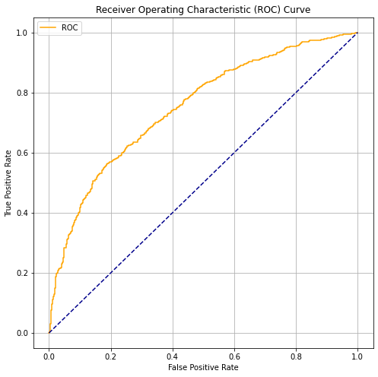
Abacus Machine Learning (ML)/Artificial Intelligence (AI) Practice
Outcome Prediction & Stratification
  Current Success: Machine Learning model used to identify future risk to avoid hospitalizations (72%)
  Member's risk guides outreach
  strategy, messaging and frequency
  with integration into other
  program service delivery areas
  Data Normalization and Augmentation
  with evidence-based, externally-
  sourced calculated features and
  classifiers
  AI Model Creation using Binary Search Decision Tree and Neural Network approaches (Scikit-learn, Jupyter Notebook) using evolutionary algorithm hyper-parameter tuning & oversampling
  Build out of ML Operational Pipeline:
  Ongoing process cycle
  Data export and augmentation
  ML Model output
  Import AI predictions to DW
  Model refinement
Predictions in Progress:
Program Success
Program Participation
2022 Copyright Abacus Health Solutions, LLC

Slide 17
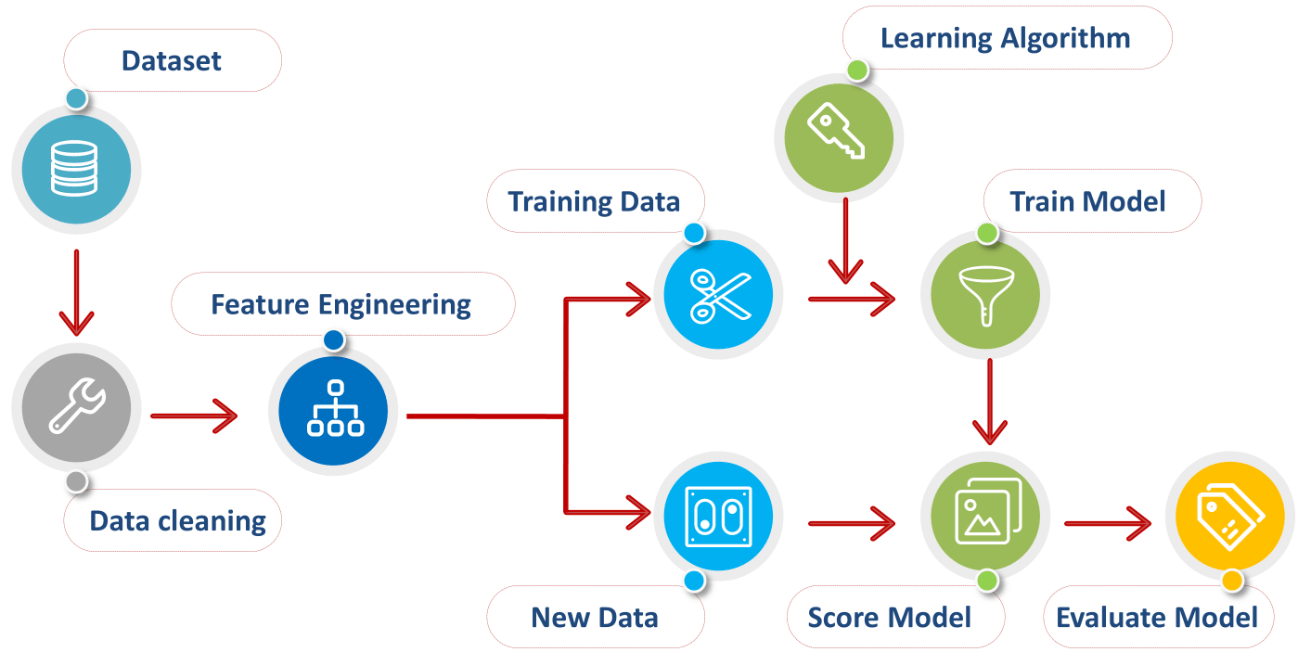
AI/ML Process Overview
Source: https://medium.datadriveninvestor.com/data-preprocessing-3cd01eefd438

Slide 18
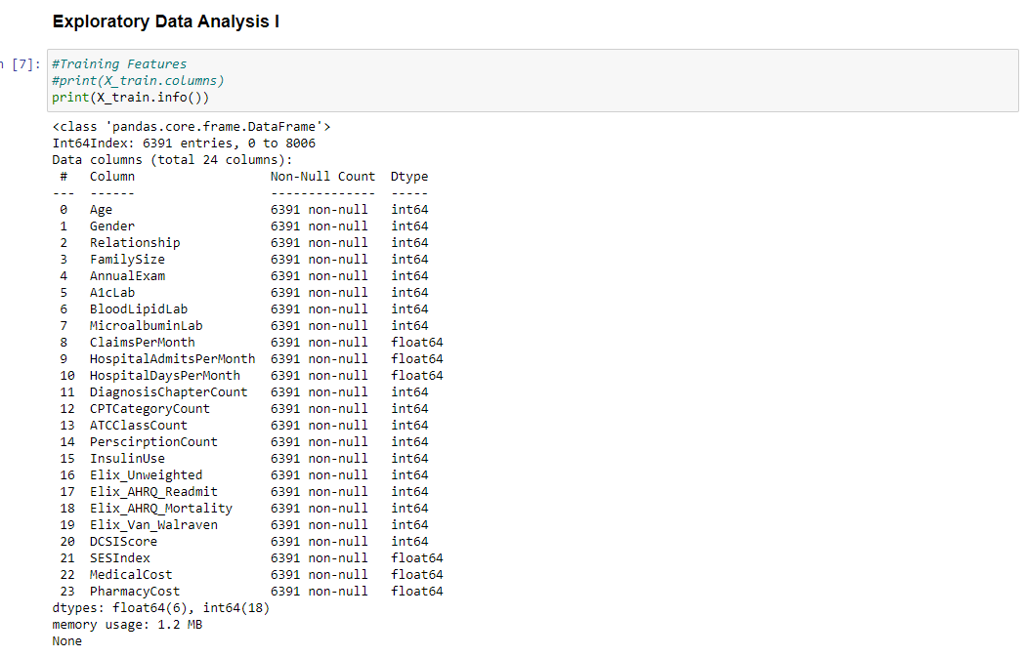

Slide 19
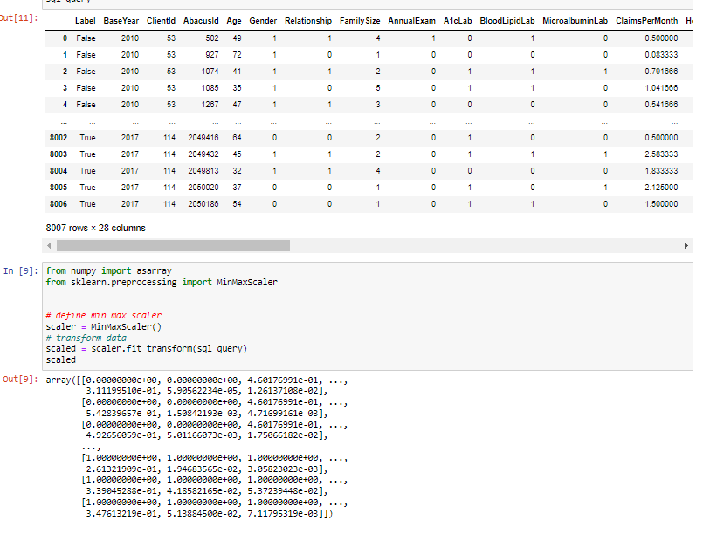

Slide 20
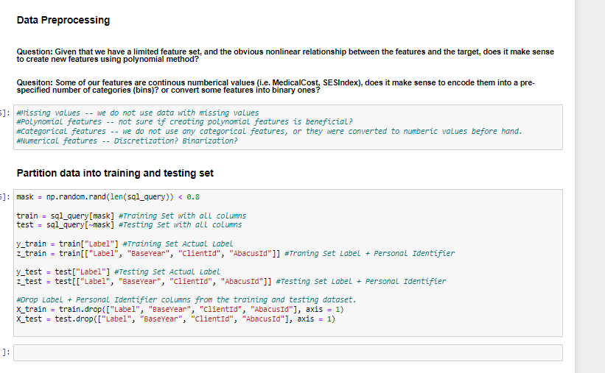

Slide 21
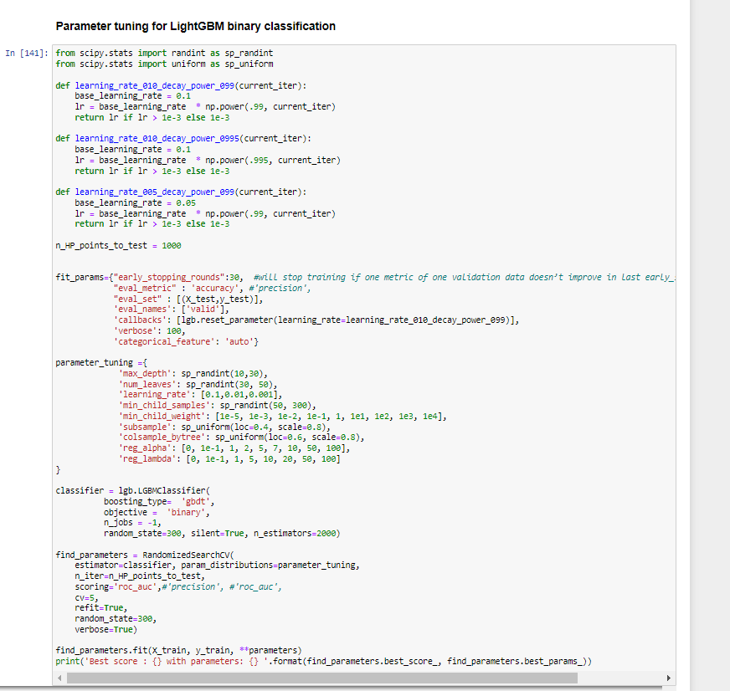

Slide 22
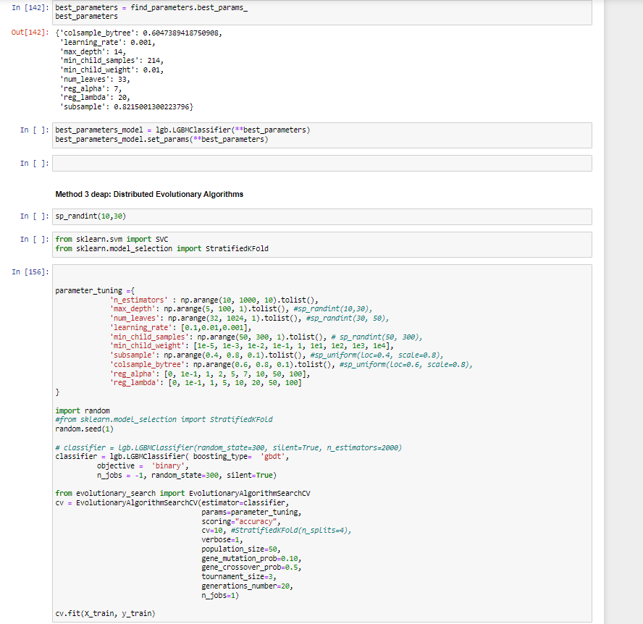

Slide 23
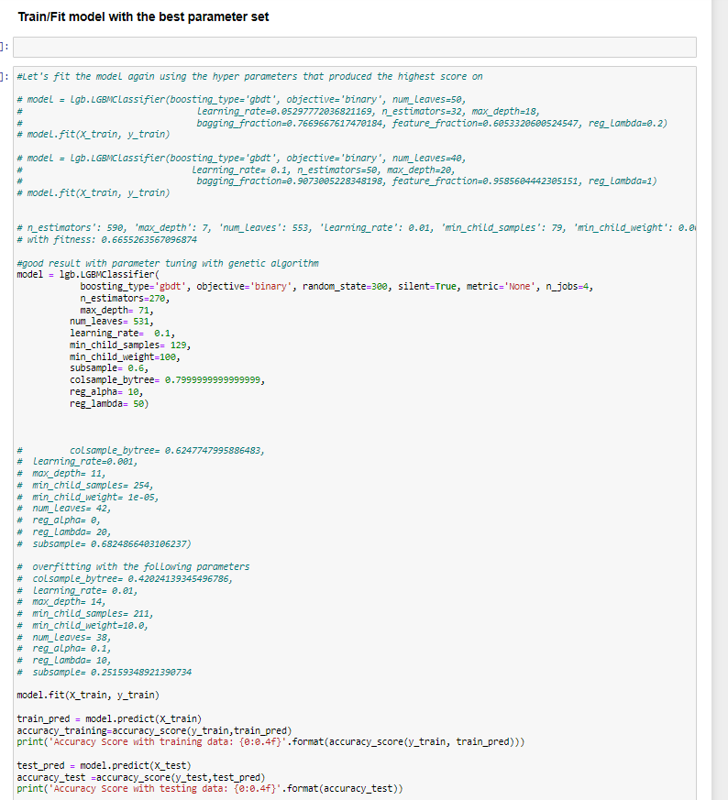

Slide 24
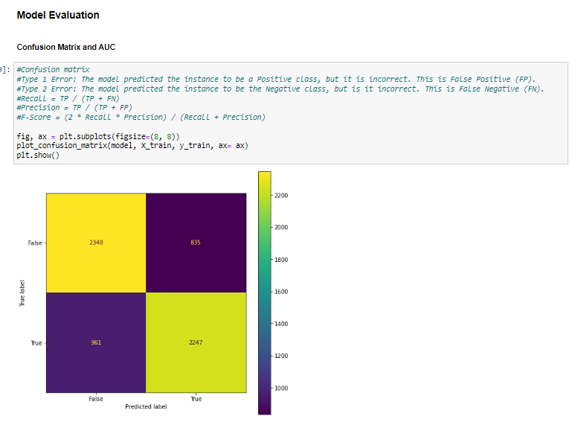

Slide 25
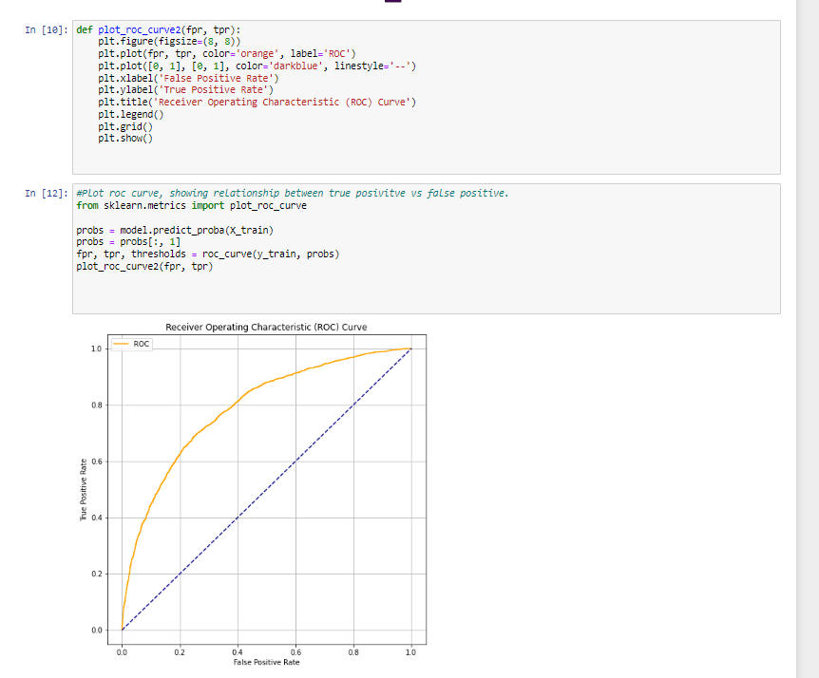

Slide 26
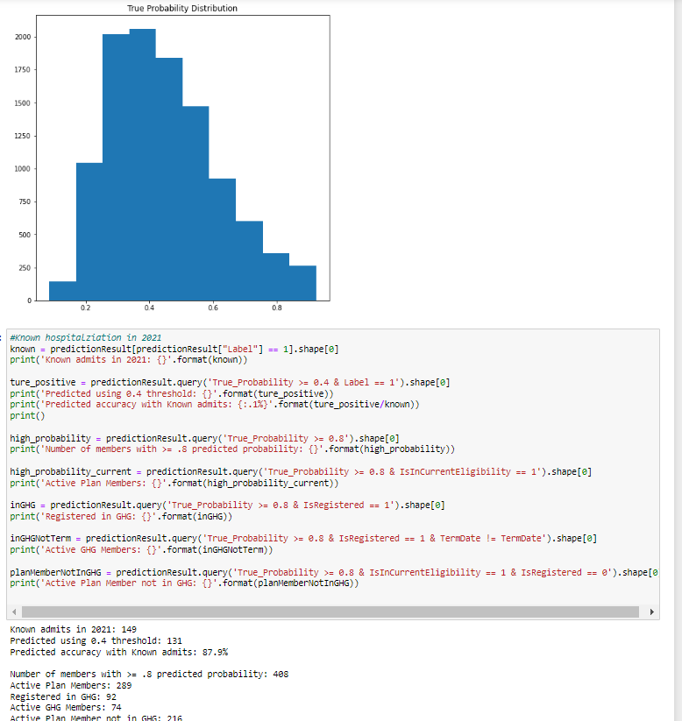

Slide 27
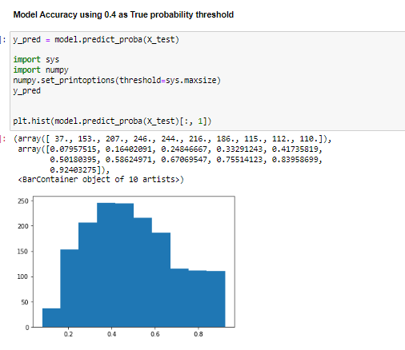

Slide 28
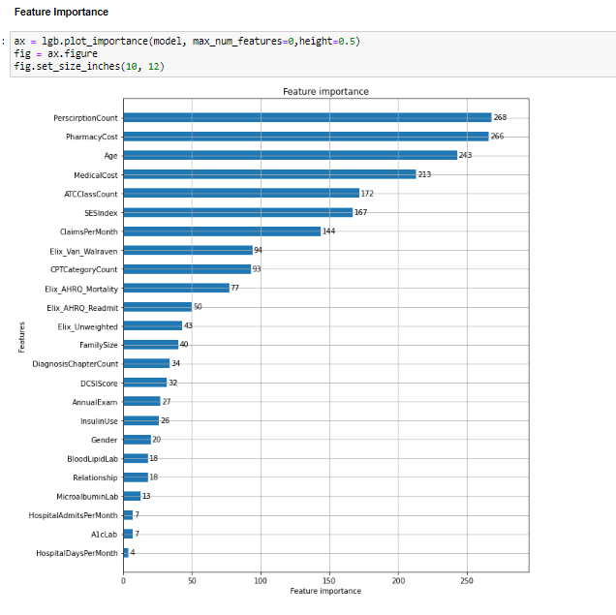

Slide 29
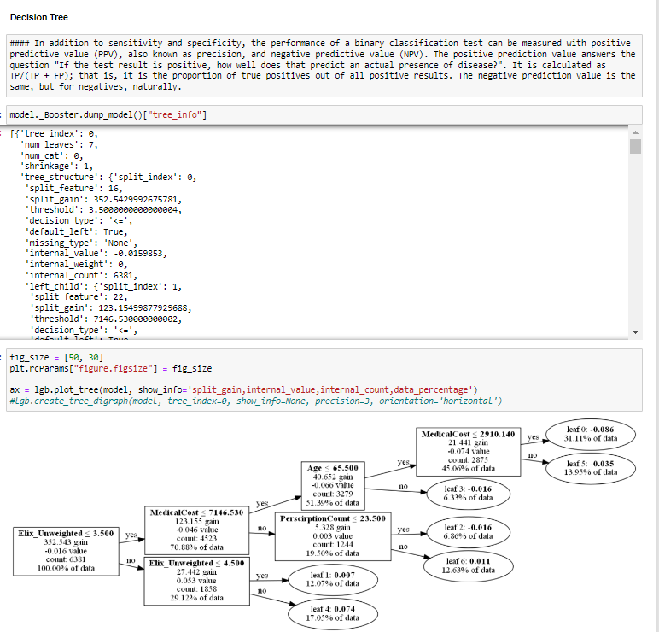

Slide 30

What now…
Plan for an internship
Start a technology project on your own or with friends
Learn basic networking
Group Study
Stay Active and Use Any Available Resource
  Student Rates
  Conferences, Cloud Computing, Dev platforms
Notes:
Ed

Slide 31


Next Steps
Questions?
Internships
2022 Copyright Abacus Health Solutions, LLC

